Slide 1
Chapter 4: Descriptive Statistical Measures
Business Analytics, 1st edition
James R. Evans

Slide 2
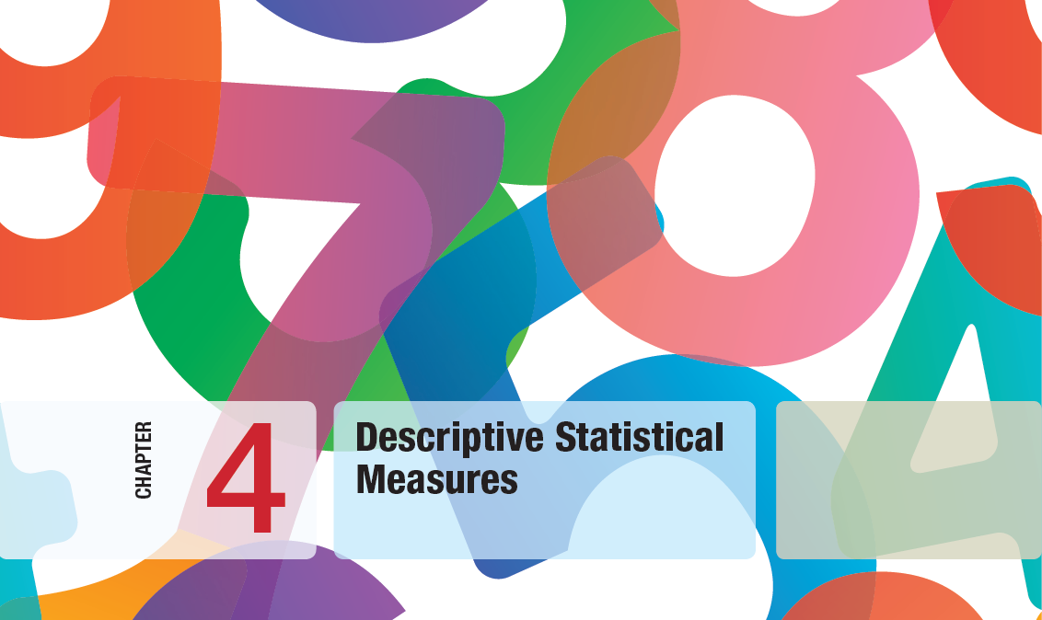

Slide 3
Chapter 4 Topics
Populations and Samples
Measures of Location
Measures of Dispersion
Measures of Shape
Excel Descriptive Statistics Tool
Descriptive Statistics for Grouped Data
Descriptive Statistics for Categorical Data: The Proportion
Statistics in PivotTables
Measures of Association
Outliers
Statistical Thinking in Business Decisions

Slide 4
Populations and Samples
Population - all items of interest for a particular decision or investigation
- all married drivers over 25 years old
- all subscribers to Netflix
Sample - a subset of the population
- a list of individuals who rented a comedy from
Netflix in the past year
The purpose of sampling is to obtain sufficient information to draw a valid inference about a population.

Slide 5
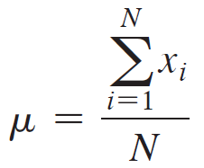
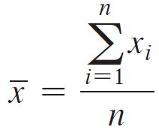

Measures of Location
Arithmetic Mean
For a population of size N:
For a sample of n observations:
Excel function: =AVERAGE(data range)
Property of the mean:
Outliers can affect the value of the mean.

Slide 6
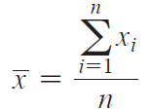
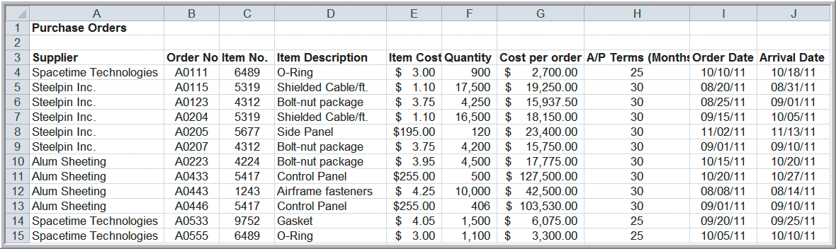
Measures of Location
Example 4.1 Computing Mean Cost per Order
(Purchase Orders data)
Using formula:
Mean = $2,471,760/94
= $26,295.32
Figure 4.1

Slide 7
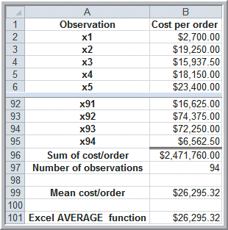
Measures of Location
Example 4.1 (continued)
Computing Mean Cost per Order
Applying Formula
=Sum(B2:B95)/Count(B2:B95)
Using Average Function
=Average(B2:B95)
Figure 4.2

Slide 8
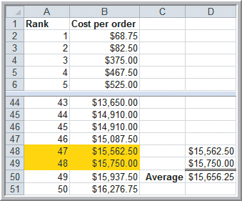
Measures of Location
Example 4.2 Finding the Median Cost per Order
(Purchase Orders data)
Median - middle value of the data when arranged from least to greatest
Sort the data in column B.
Since n = 94,
Median = $15,656.25
= average of 47th and
48th observations.
=MEDIAN(B2:B94)
=Average(B48,B49)
Figure 4.3

Slide 9
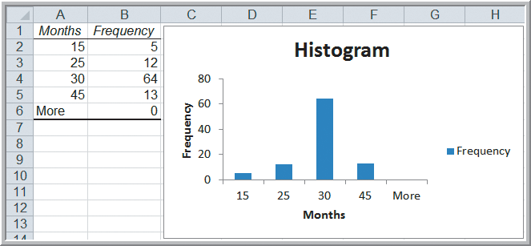
Measures of Location
Example 4.3 Finding the Mode of A/P terms
(Purchase Orders data)
Mode - observation that occurs most often or, for grouped data, the group with the greatest frequency.
Mode of A/P terms:
= 30 months
=MODE.SNGL(H4:H97)
For multiple modes: =MODE.MULT(data range)
Figure 3.29

Slide 10
Measures of Location
Example 4.4 Computing the Midrange
(Purchase Orders data)
Midrange = Average of greatest and least values
Use the Excel MIN and MAX functions or Sort the data and find them easily.
Cost per order midrange:
= ($68.78 + $127,500)/2
= $63,784.89
=AVERAGE(MIN(B2:B95), MAX(B2:B95))

Slide 11
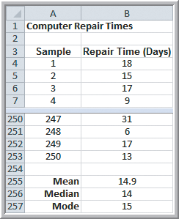
Measures of Location
Example 4.5 Quoting Computer Repair Times
Data set includes 250 repair times for customers.
What repair time would be reasonable to quote to a new customer?
Median repair time is 2 weeks; Mean and Mode are about 15 days.
Let’s look at a histogram to get a better idea.
Figure 4.4

Slide 12
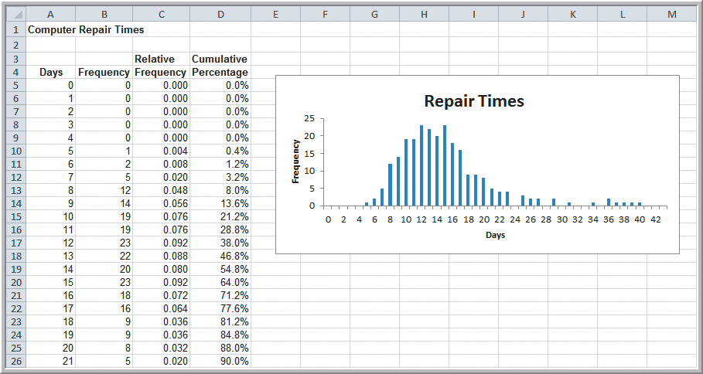
Measures of Location
Example 4.5 (continued)
Quoting Computer Repair Times
90% are completed within 3 weeks
Figure 4.5

Slide 13
Measures of Dispersion
Dispersion refers to the degree of variation in the data.
Range is the difference between the maximum and minimum data values.
Interquartile Range (IQR) is difference between the third and first quartiles.
Variance is an average of the squared deviations form the mean (uses all data values).
Standard Deviation is the square root of the variance.

Slide 14
Measures of Dispersion
Example 4.6 Computing the Range
(Purchase Orders data)
For the cost per order data:
Maximum = $127,500
Minimum = $68.78
Range = $127,431.22
=MAX(B2:B95)−MIN(B2:B95)

Slide 15
Measures of Dispersion
Example 4.7 Computing the Interquartile Range
(Purchase Orders data)
For the cost per order data:
Third Quartile = Q₃ = $27,593.75
=QUARTILE.INC(B2:B95,3)
First Quartile = Q₁ = $6,757.81
=QUARTILE.INC(B2:B95,1)
Interquartile Range = $20,835.94
The middle 50% of the data is concentrated in a small range of $20,836.
The range of the full data set is affected by extreme values.

Slide 16
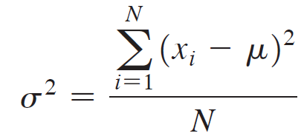
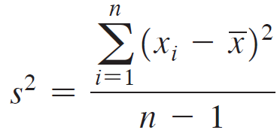
Measures of Dispersion
Computing the Variance
For a population:
In Excel: =VAR.P(data range)
For a sample:
In Excel: =VAR.S(data range)

Slide 17
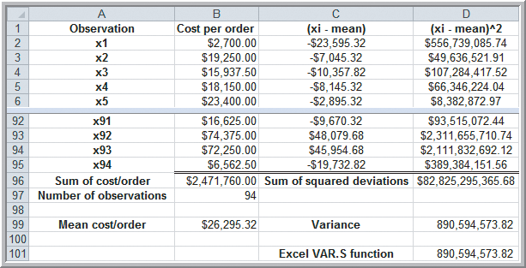
Measures of Dispersion
Example 4.8 Computing the Variance
(Purchase Orders data)
=VAR.S(B2:B95)
Figure 4.6

Slide 18
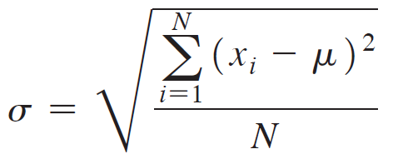
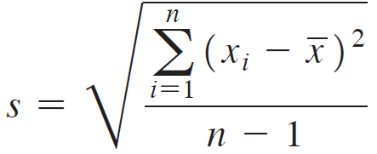
Measures of Dispersion
Computing the Standard Deviation
For a population:
=STDEV.P(data range)
For a sample:
=STDEV.S(data range)

Slide 19
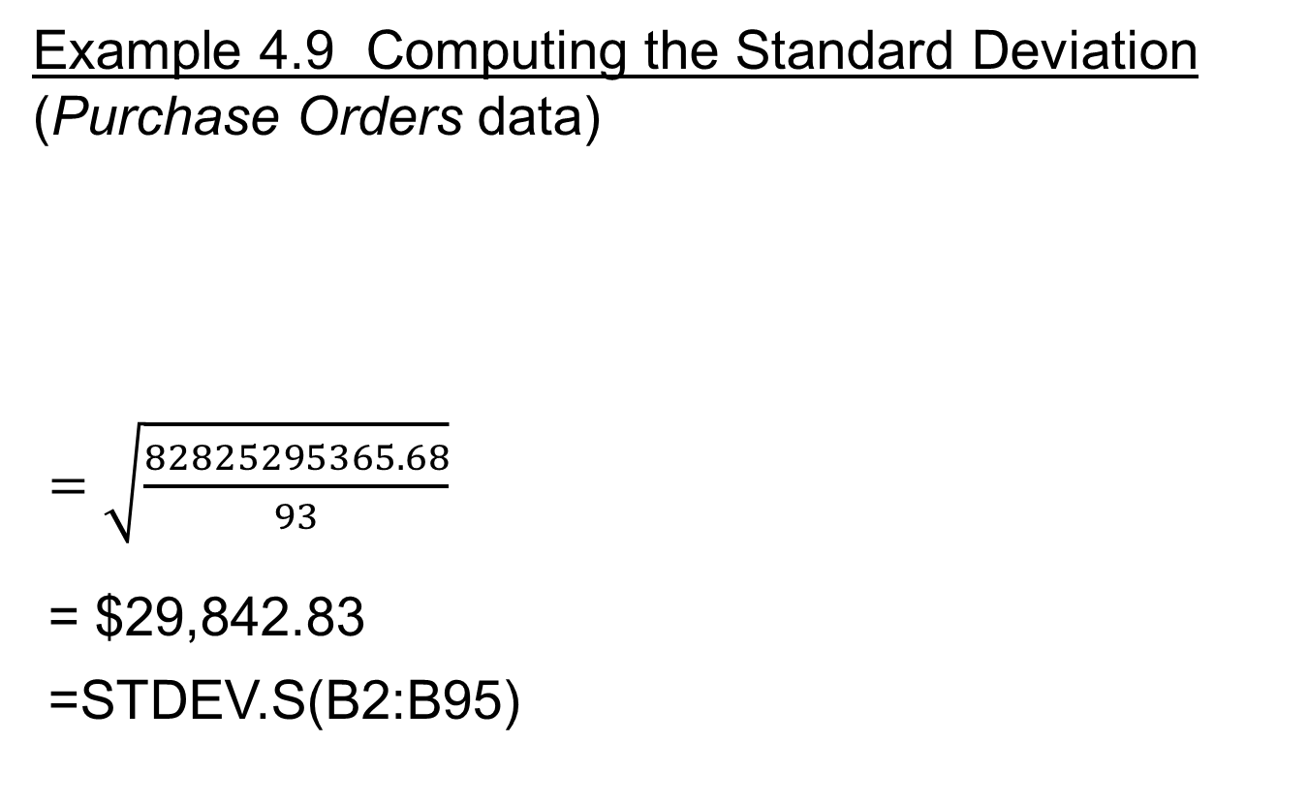
Measures of Dispersion
Figure 4.6

Slide 20
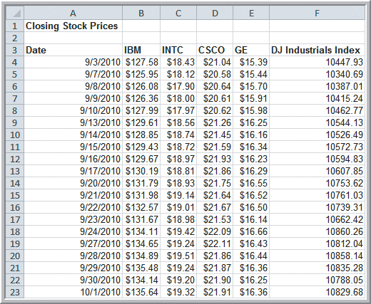
Measures of Dispersion
Mean & Standard Deviation of Closing Stock Prices
Intel (INTC):
Mean = $18.81
Stdev. = $0.50
General Electric (GE):
Mean = $16.19
Stdev. = $0.35
INTC is a higher risk
investment than GE.
Figure 4.7

Slide 21



Measures of Dispersion
Chebyshev’s Theorem
For any data set, the proportion of values that lie within k (k > 1) standard deviations of the mean is
at least 1 – 1/k²
Empirical Rules
For many data sets encountered in practice:
Approximately 68% of the observations fall within one standard deviation of the mean; that is, between
Approximately 95% fall within 2 →
Approximately 99.7% fall within 3 →

Slide 22
Measures of Dispersion
Example 4.10 Applying Chebyshev’s Theorem
(Purchase Orders data)
For the cost-per-order data
When k = 2, 1-1/k² = 75%
Mean ± 2(Stdev.) = [-$33,390.34, $85,980.98]
89 of the 94 data values (94.68%)
When k = 3, 1-1/k² = 89%
Mean ± 3(Stdev.) = [-$63,233.17, $115,823.81]
92 of the 94 data values (97.9%)

Slide 23
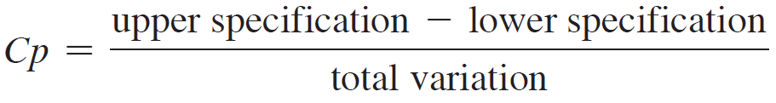
Measures of Dispersion
Process Capability Index (C_{p})
To measure how well a manufacturing process can achieve specifications, take a sample of output, measure dimensions, compute the total variation using the third empirical rule.
Compare results to specifications using:

Slide 24
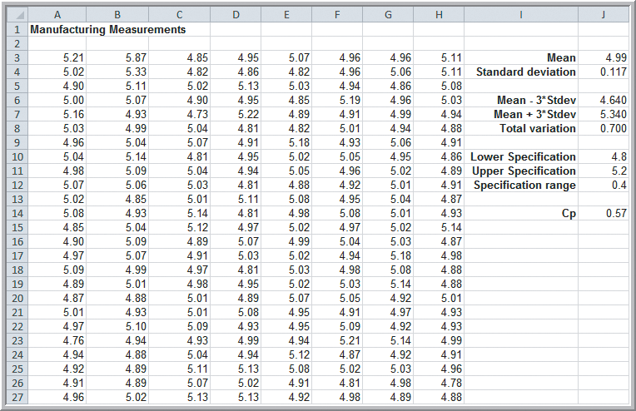
Measures of Dispersion
Example 4.11 Using the Empirical Rule to Measure the Capability of a Manufacturing Process
C_{p} = 0.57
C_{p} < 1 indicates
variation is
wider than
specified.
Want C_{p} ≥ 1
or C_{p} ≥ 1.5
Figure 4.8

Slide 25
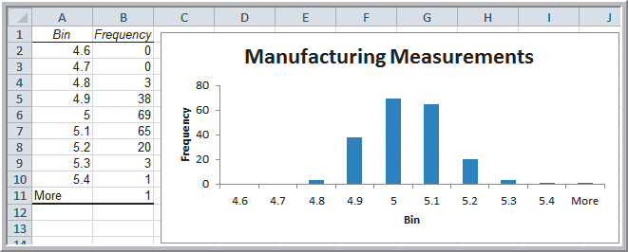
Measures of Dispersion
Example 4.11 (continued)
3+3+1+1 = 8 of 200 (4%) fall outside the specification limits of between 4.8 and 5.2.
3rd Empirical Rule: approximately 0.3% of the data falls outside 3 standard deviations of the mean.
Chebyshev’s Theorem: less than 11% fall outside.
Figure 4.9

Slide 26
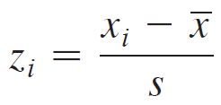
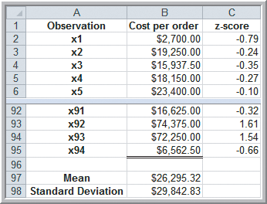
Measures of Dispersion
Example 4.12 Computing z-scores
(Purchase Orders data)
=STANDARDIZE(x, mean, standard deviation)
Figure 4.10

Slide 27
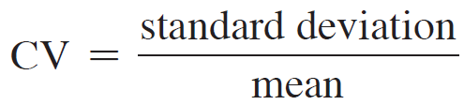
Measures of Dispersion
Coefficient of Variation (CV)
Provides a relative measure of dispersion
Sometimes measured as a percentage.
Provides a relative measure of risk to return.
Return to risk = 1/CV
Sharpe ratio is a related measure in finance.
Sharpe ratio = excess returns/standard deviation

Slide 28
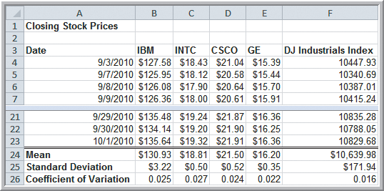
Measures of Dispersion
Example 4.13 Applying the Coefficient of Variation
Intel (INTC) is slightly riskier than the other stocks.
The Index fund has the least risk (lowest CV).
Figure 4.11

Slide 29
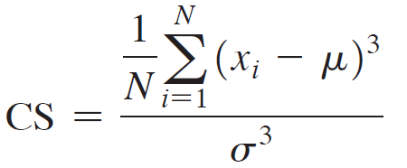
Measures of Shape
Skewness describes lack of symmetry.
Coefficient of Skewness =
=SKEW(data, range)
CS is negative for left-skewed data.
CS is positive for right-skewed data.
|CS| > 1 suggests high degree of skewness.
0.5 ≤ |CS| ≤ 1 suggests moderate skewness.
|CS| < 0.5 suggests relative symmetry.

Slide 30
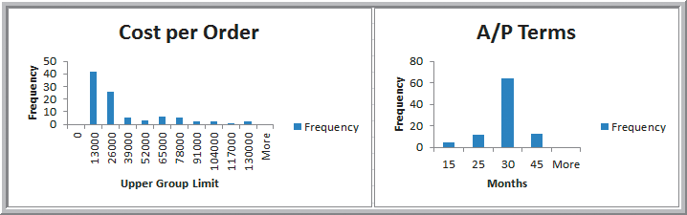
Measures of Shape
Example 4.14 Measuring Skewness
For cost per order: CS = 1.66 (high)
For A/P terms: CS = 0.60 (moderate)
Figure 4.12

Slide 31
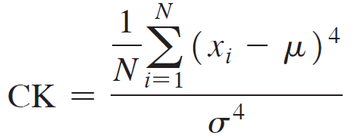
Measures of Shape
Kurtosis refers to peakedness or flatness.
Coefficient of Kurtosis =
=KURT(data, range)
CK < 3 indicates the data is somewhat flat with a wide degree of dispersion.
CK > 3 indicates the data is somewhat peaked with less dispersion.

Slide 32
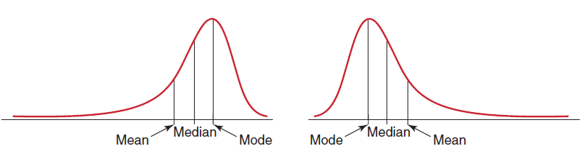
Measures of Shape
Negatively skewed
Mean < Median < Mode
Positively skewed
Mode < Median < Mean
Figure 4.13

Slide 33
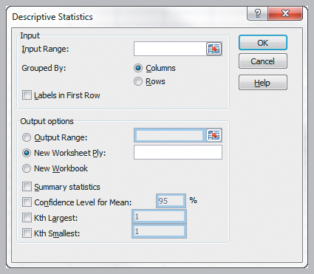
Excel Descriptive Statistics Tool
This tool provides a summary of numerical statistical measures for sample data.
Data
Data Analysis
Descriptive Statistics
Enter Input Range
Labels (optional)
Summary Statistics
Figure 4.14

Slide 34
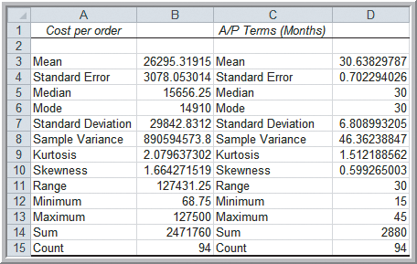
Excel Descriptive Statistics Tool
Example 4.15 Using the Descriptive Statistics Tool
Descriptive Statistics for Cost per order and A/P terms
Results of the Analysis Toolpak do not change when changes are made to the data itself.
Figure 4.15

Slide 35
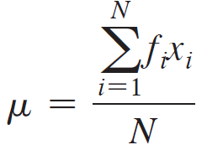
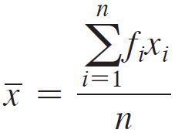
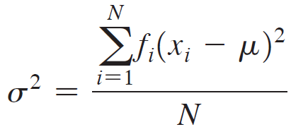
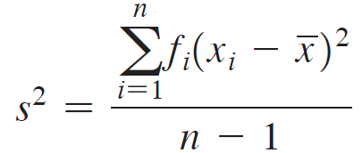
Descriptive Statistics for Grouped Data
Computing Statistical Measures from Frequency Distributions
Mean formulas:
Variance formulas:

Slide 36
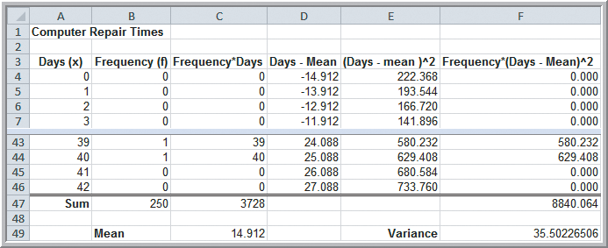
Descriptive Statistics for Grouped Data
Example 4.16 Computing Statistical Measures from Frequency Distributions (Computer Repair Times)
Figure 4.16

Slide 37
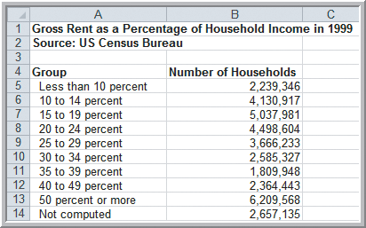
Descriptive Statistics for Grouped Data
Example 4.17 Computing Descriptive Statistics for a Grouped Frequency Distribution
We can use group midpoints as approximate percentages of household income spent on rent (except in rows 13, 14).
Figure 4.17

Slide 38
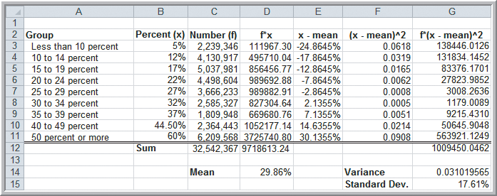
Descriptive Statistics for Grouped Data
Example 4.17 (continued)
Our calculations indicate that the typical renter spends about 30% of household income on rent.
Figure 4.18

Slide 39
Descriptive Statistics for Categorical Data: The Proportion
Example 4.18 Computing a Proportion
Proportion of orders placed by Spacetime Technologies
=COUNTIF(A4:A97, “Spacetime Technologies”)/94
= 12/94 = 0.128
Figure 4.1

Slide 40
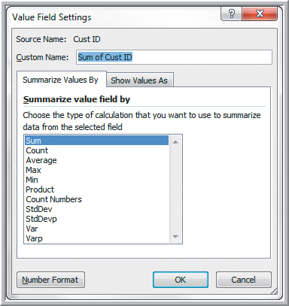
Statistics in PivotTables
Statistical Measure Choices in PivotTables
Under Value Field Settings:
Average
Max and Min
Product
Standard deviation
Variance
Figure 4.19

Slide 41
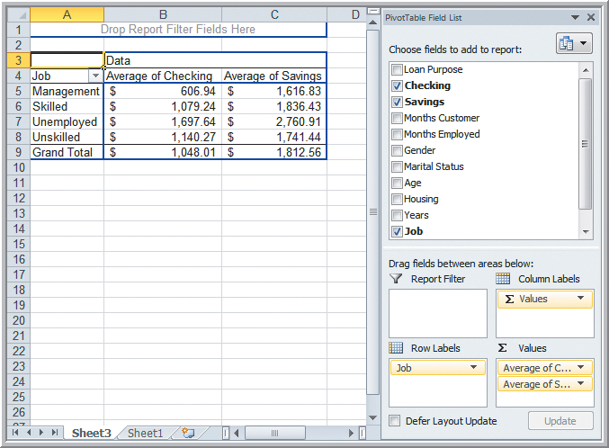
Statistics in PivotTables
Example 4.19 Statistical Measures in PivotTables
(Credit Risk Data)
Fields: Checking
Savings
Job Classif.
Row Labels: Job
Σ Values:
Average Checking
Average Savings
Figure 4.20

Slide 42
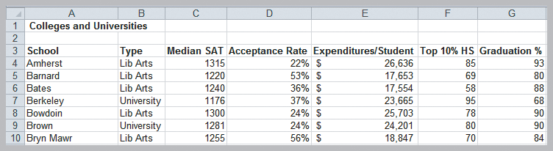
Measures of Association
Data from 49 top liberal arts and research universities can be used to answer questions:
Is Top 10% HS related to Graduation %?
Is Accept. Rate related to Expenditures/Student?
Is Median SAT related to Acceptance Rate?
Figure 4.21

Slide 43
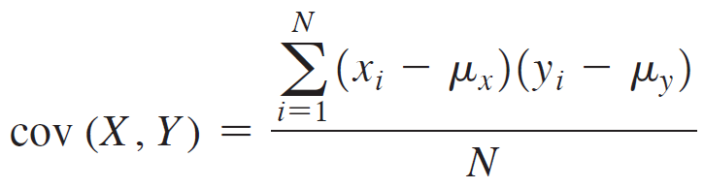
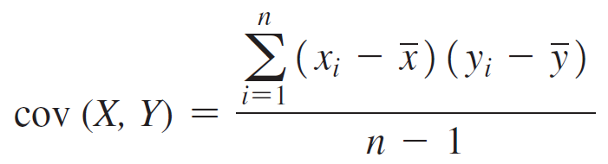
Measures of Association
Covariance is a measure of the linear association between two variables, X and Y.
For a population:
=COVARIANCE.P(array1, array2)
For a sample:
=COVARIANCE.S(array1, array2)

Slide 44
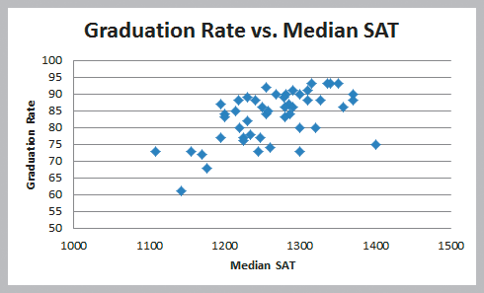
Measures of Association
Example 4.20 Computing the Covariance
Scatterplot of the Colleges and Universities data
Figure 4.22

Slide 45
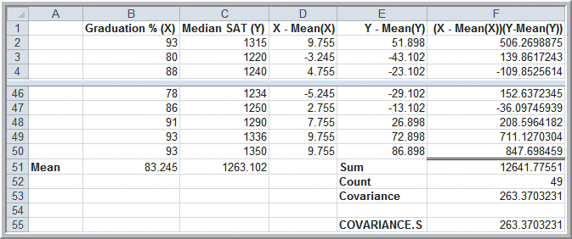
Measures of Association
Example 4.20 (continued)
Computing the Covariance
Figure 4.23

Slide 46
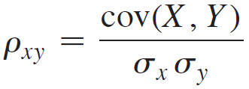
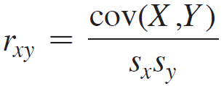
Measures of Association
Correlation is a measure of the linear association between two variables, X and Y.
Correlation Coefficient formulas:
=CORREL(array1, array2)
The Correlation Coefficient does not depend upon units of measurement (unlike covariance).
Also known as the:
Pearson product moment correlation
For a population:
For a sample:

Slide 47
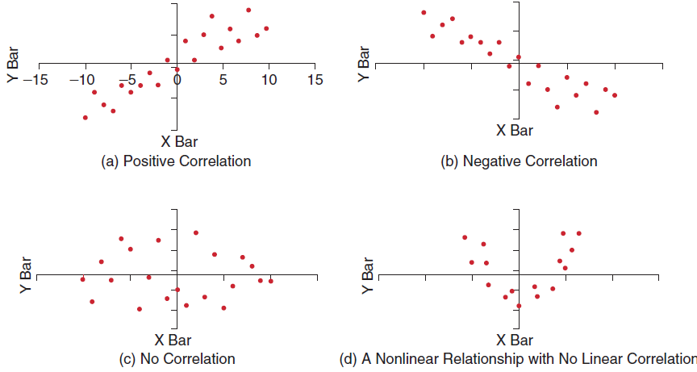
Measures of Association
Figure 4.24

Slide 48
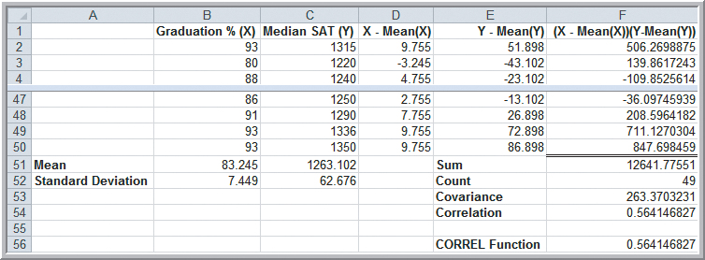
Measures of Association
Example 4.21 Computing the Correlation Coefficient (Colleges and Universities data)
Graduation % and Median SAT
Figure 4.25

Slide 49
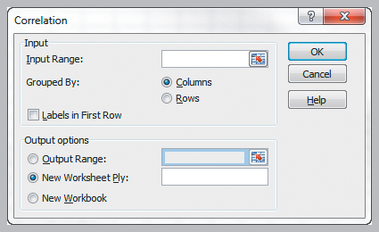
Measures of Association
Excel Correlation Tool
Data
Data Analysis
Correlation
Excel computes the
correlation coefficient
between all pairs of variables in the Input Range.
Input Range Data must be in contiguous columns.
Figure 4.26

Slide 50
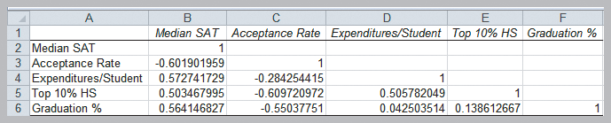
Measures of Association
Example 4.22 Using the Correlation Tool
(Colleges and Universities data)
Lower acceptance rate, higher median SAT
Lower acceptance rate, higher % top 10 HS students
Lower acceptance rate, higher graduation rate
Higher median SAT, higher graduation rate
Figure 4.27

Slide 51
Outliers
The Mean and Range are sensitive to outliers.
How do we identify outliers?
Some possible methods to identify outliers are:
z-scores greater than +3 or less than -3
extreme outliers are more than 3*IQR to the left of Q₁ or right of Q₃
mild outliers are between 1.5*IQR and 3*IQR to the left of Q₁ or right of Q₃
There is no standard definition of what constitutes an outlier.

Slide 52

Outliers
Example 4.23 Investigating Outliers
(Home Market Value data)
Are any homes outliers?
Note that the
complete data set has 43 observations.
Figure 4.28

Slide 53

Outliers
Example 4.23 (continued) Investigating Outliers
None of the z-scores for Square Feet or
Market Value exceed 3.
Figure 4.29

Slide 54

Outliers
Example 4.23 (continued) Investigating Outliers
The house with a market value near $120,000 and square footage near 1600 does not fall in line with the rest of the data.
Figure 4.30

Slide 55
Statistical Thinking in Business Decisions
Statistical Thinking is a philosophy of learning and action for improvement, based on principles that:
all work occurs in a system of interconnected processes
variation exists in all processes
better performance results from understanding and reducing variation
Business Analytics provide managers with insights into facts and relationships that enables them to make better decisions.

Slide 56

Statistical Thinking in Business Decisions
Example 4.24 Applying Statistical Thinking
Average infection rate = 0.0072
Standard deviation = 0.0053
Figure 4.31

Slide 57

Statistical Thinking in Business Decisions
Example 4.24 (continued) Applying Statistical Thinking (Surgery Infections data)
Control limits set at z-scores of -3 and +3
Control limits: -0.009 (set to 0) and 0.0023
Figure 4.32

Slide 58

Statistical Thinking in Business Decisions
Example 4.25 Variation in Sample Data
Population: 250 computer repair times
μ = 14.91 days, σ² = 35.5 days²
Two samples of size n = 50
Figure 4.33

Slide 59

Statistical Thinking in Business Decisions
Example 4.25 (continued) Variation in Sample Data
The two n = 25 samples have higher variation than the population and the n = 50 samples.
Two samples of size n = 25
Figure 4.34

Slide 60

Statistical Thinking in Business Decisions
Analytics in Practice:
Applying Statistical Thinking to
Detecting Financial Problems
Sarbanes-Oxley Act (2002)
helped improve the quality of data that companies disclose to the public but companies can still commit financial fraud.
Anomaly detection scores (a form of z-score) are often used by the SEC to detect companies committing financial fraud.

Slide 61
Chapter 4 - Key Terms
Arithmetic mean (mean)
Bimodal
Chebyshev’s theorem
Coefficient of kurtosis
Coefficient of skewness
Coefficient of variation
Correlation
Correlation coefficient (Pearson product
moment correlation
coefficient)
Covariance
Dispersion
Empirical rules
Interquartile range (midspread)
Kurtosis
Median
Midrange
Mode
Outlier

Slide 62
Chapter 4 - Key Terms (continued)
Population
Process capability index
Proportion
Range
Return to risk
Sample
Sample correlation coefficient
Skewness
Standard deviation
Standardized value (z-score)
Statistical thinking
Unimodal
Variance

Slide 63


Case Study Performance Lawn Equipment (4)
Recall that PLE produces lawnmowers and a medium size diesel power lawn tractor.
Compute the mean satisfaction ratings by year and region and provide descriptive statistics for the 2012 customer survey data.
Determine how responses times change quarterly.
Examine changes in defects over time.
Compare sales with industry totals and write a formal report summarizing your results.

Slide 64


